Slide 1
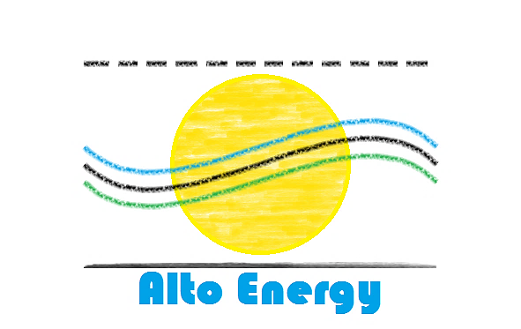




SENIOR DESIGN TEAM #14 SOLAR THERMAL GENERATOR

Slide 2
DESIGN ASPECTS
SYSTEM INTEGRATION/HARDWARE DESIGN – ERNEST CRABTREE, EE
CONTROL PROGRAMMING/ BUDGET – SHAZEEN TARIQ, CE
GPS LOCATION AND TRACKING ALGORITHM – WILLIAM SIDEBOTTOM, CE
VOLTAGE CONDITIONING – JASON GALLA, EE
ENERGY STORAGE AND CHARGING – DYLAN LEE, EE
HEAT TRANSFER/WEBMASTER – BENJAMIN GALIVAN, EE

Slide 3
PROBLEM STATEMENT
Generate 20W of power from a portable solar collector design that utilizes the Seebeck effect through implementation of thermal electric generators.
Track the sun across the sky from any location and time of year.
Provide removable energy storage that can be implemented in a modular system.
Design a user friendly device with little to no maintenance.

Slide 4
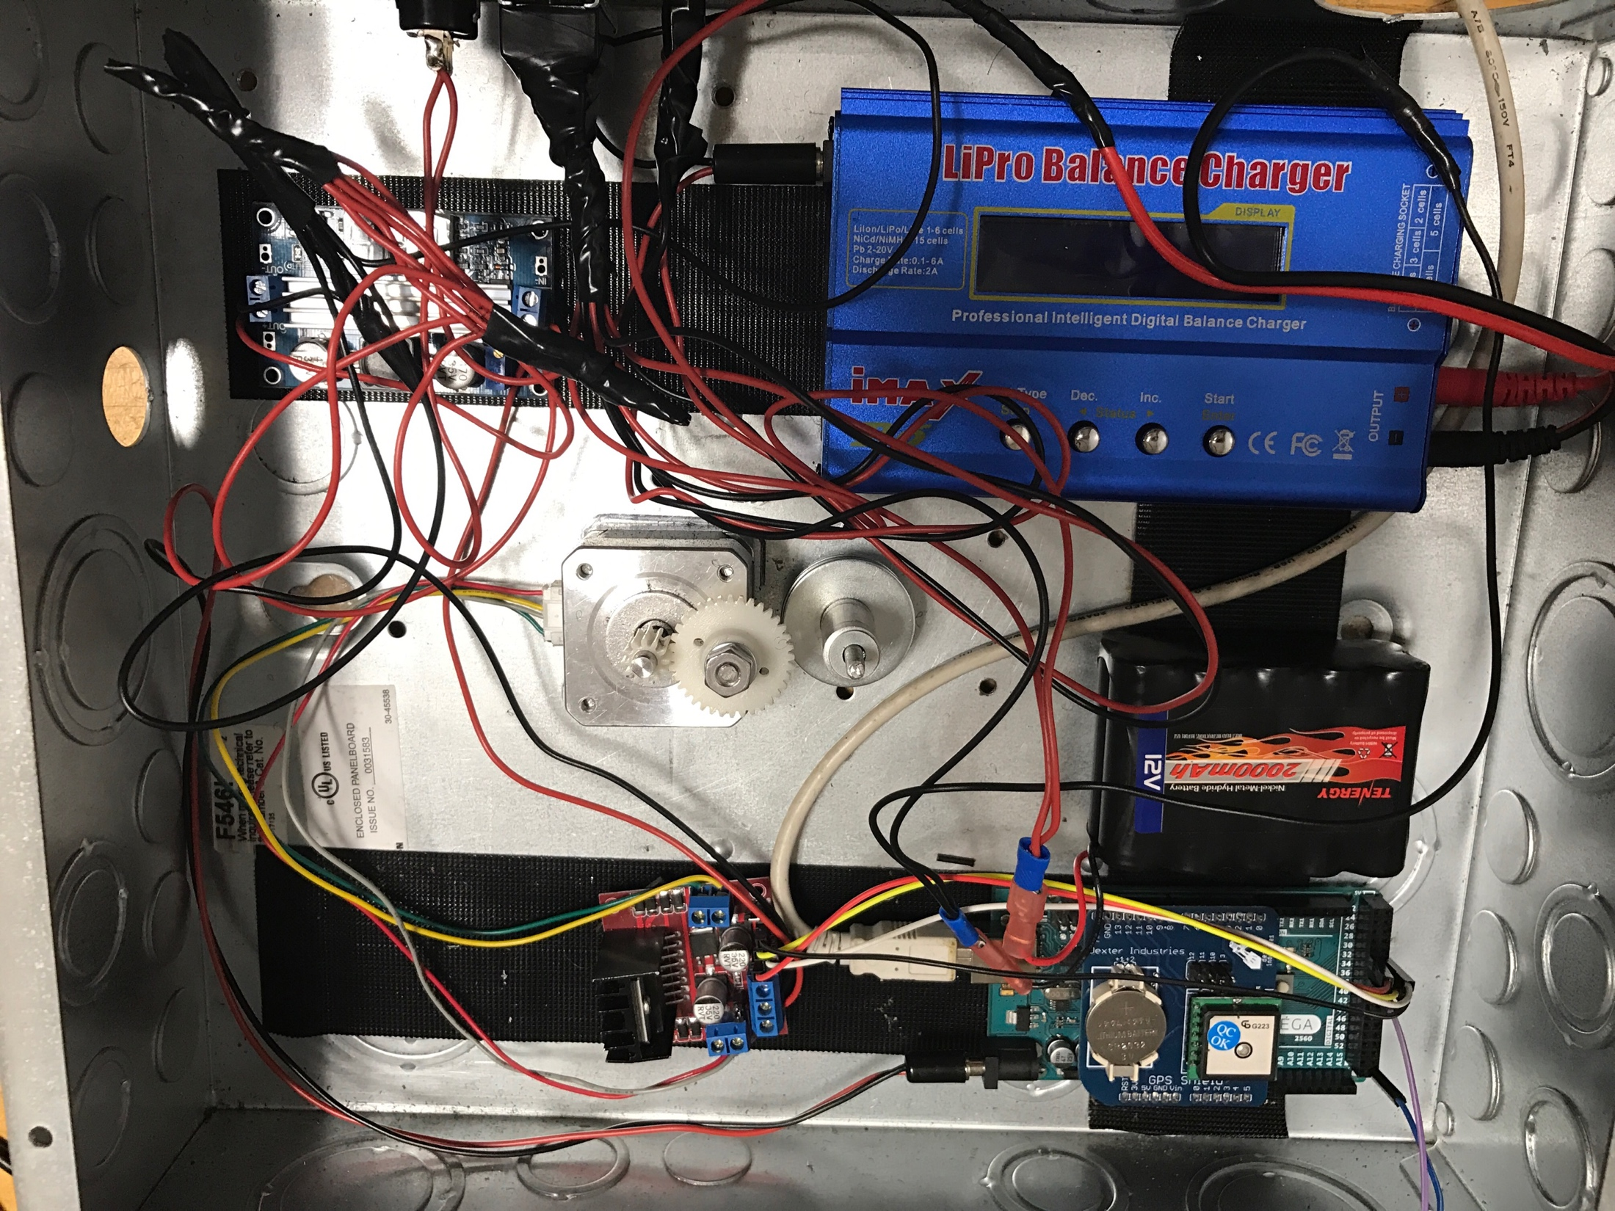
SOLUTION
Main Components:
Reflective parabolic dish
Thermoelectric Generator Chips
Arduino Microprocessor
Boost Converter
Battery Charger
10 Nickel Metal Hydride battery cells
Stepper Motor
DC Motor
Reflective mirror
Note: Mechanical Operation was designed and fabricated by the team

Slide 5
Thermal Electric Generator Chip
Operation governed by the Seebeck effect
Seebeck effect converts temperature differentials to electrical energy through charge diffusion
Utilizes the entire spectrum of light
Allows for wider range of operation and strengthened durability compared to photovoltaic applications

Slide 6
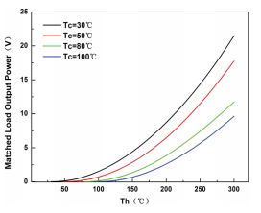
Verification/Testing
Power Requirements
Maximum output from single chip under ideal conditions is 22 Watts
Project objective is 20 Watts chip output in full sunlight
Implemented a single chip design to test output
Realistically we can expect approximately 10 Watts
Ideal hot and cold side temperatures are 295°C (568K) and 30°C (303K) respectively

Slide 7
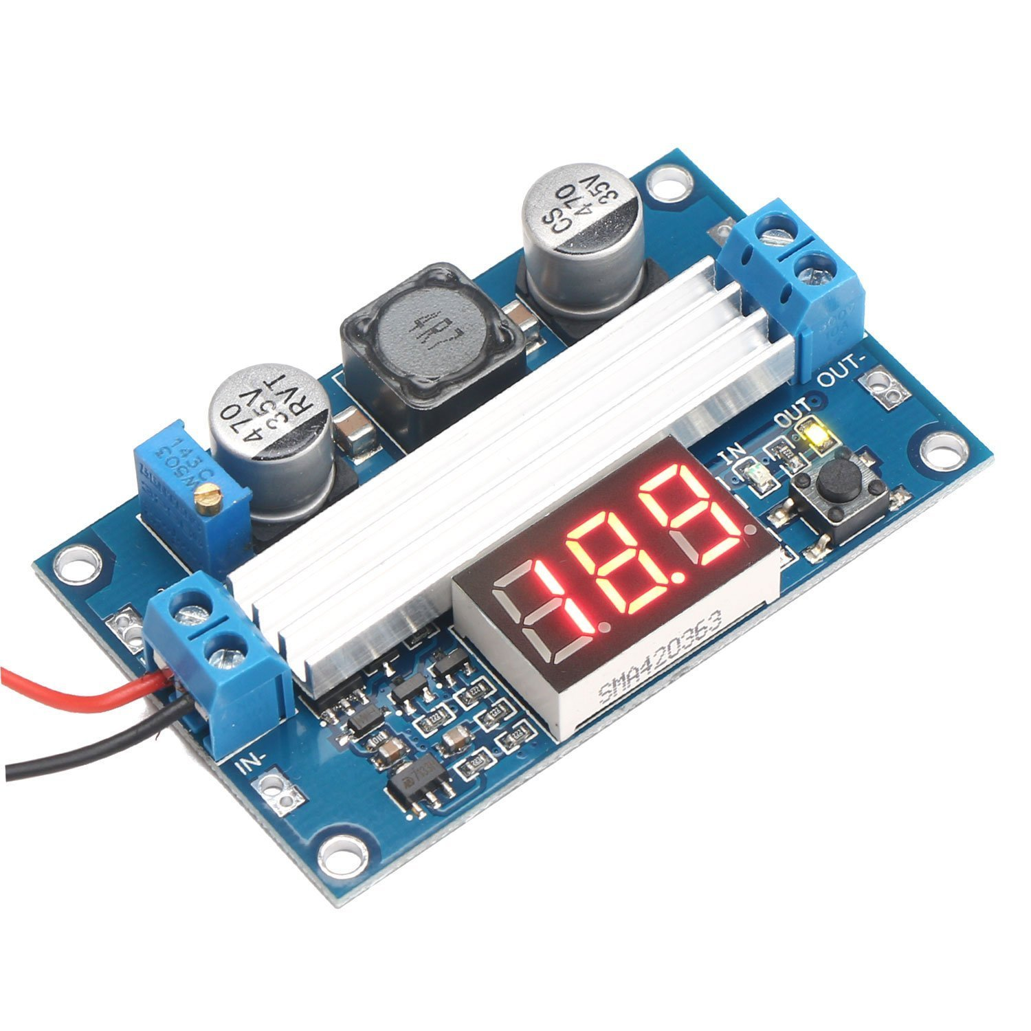
Power Regulation
Boost converter was originally going to be designed and implemented by team
More difficult and more expense than was expected
Purchased boost converter to implement
Can supply 6A at 12V – well above what is required
High efficiency (Claims up to 98%, 90% observed)

Slide 8
Battery Charger/Discharger
IMAX B6 is an intelligent multifunction charger which can charge and discharge NiMH batteries
Capable of charging/discharging our 10 NiMH cells
Operating voltage between 11 V and 18 V
Charging Current : 0.5A

Slide 9
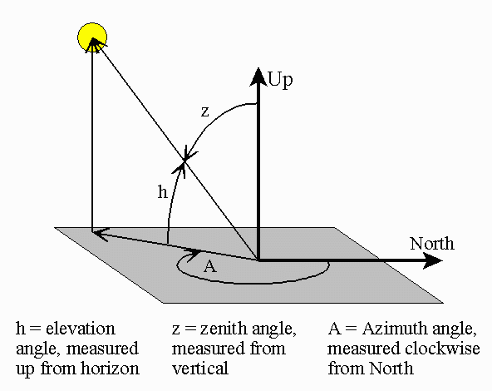
Solar Tracking
Originally tested the NREL’s solar position algorithm to track the sun.
The algorithm required too much dynamic (heap) memory than anticipated.
Switched to a smaller and slightly less efficient algorithm provided by the Institute of Earth Science.
Azimuth and Zenith angles calculated only off by tenths of a degree.

Slide 10
Solar Tracking
To test the new algorithm results were matched against those calculated from the Earth System Research Laboratory.
Coordinates and time were specifically entered for Tallahassee, FL
Output | Solar Tracking Algorithm | Earth System Research Laboratory
Zenith | 50.1645 [degrees] | 49.68 [degrees]
Azimuth | 160.9977 [degrees] | 160.76 [degrees]

Slide 11
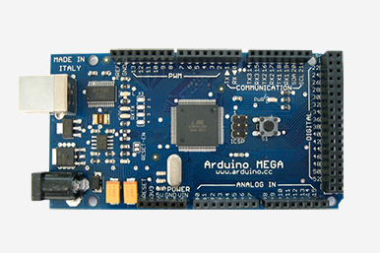
Solar Tracking
The Arduino Uno was implemented as the micro controller of choice over the TI MSP430 due to limitations with Code Composer Studio.
Header and Implementation files were created for using the Solar Tracking Algorithm as well as a more efficient stepper motor library.

Slide 12
Control Overview
Creation of heat differential to produce electric current
Boost Converter
Boost voltage from TEG’s to 12 V
Battery Charger and Batteries
Charge / Discharge Nickel Metal Hydride Batteries
Thermal Electric Generator
Power Control:
Arduino Mega and GPS Shield
SPA Algorithm
H-Bridge Driver
Allows stepper motor to operate in forward and reverse direction
Motor Operation
DC Motor is operated until elevation angle from Arduino is established
Elevation calculation
Azimuth calculation
Stepper Motor operated until azimuth angle is established
Mechanical Control:

Slide 13
Demonstration and Questions

Slide 14
Acknowledgements
OUR FACULTY ADVISOR
DR. RAJENDRA ARORA
OUR INSTRUCTORS
DR. JERRIS HOOKER
DR. MICHAEL DEVINE
OUR REVIEWER
DR. SASTRI PAMIDI
DR. JIM ZHENG
MECHANICAL CONSULTING
DR. WEI GUO
DR. SIMONE HRUDA

